Slide 1

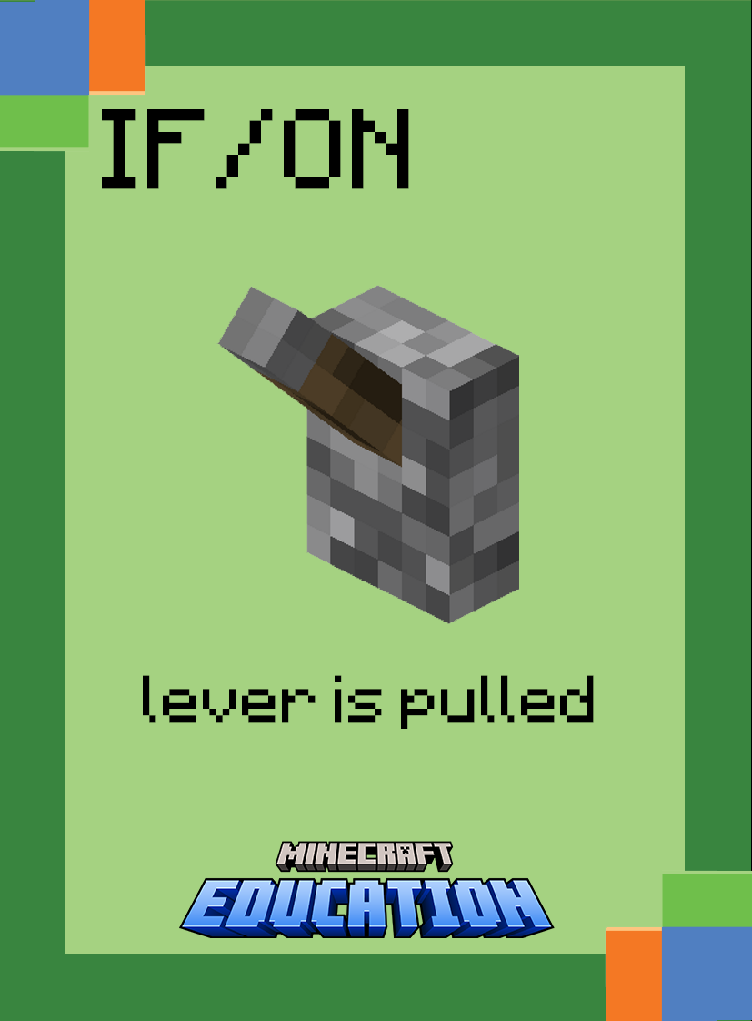


Beginners
Commands

Slide 2
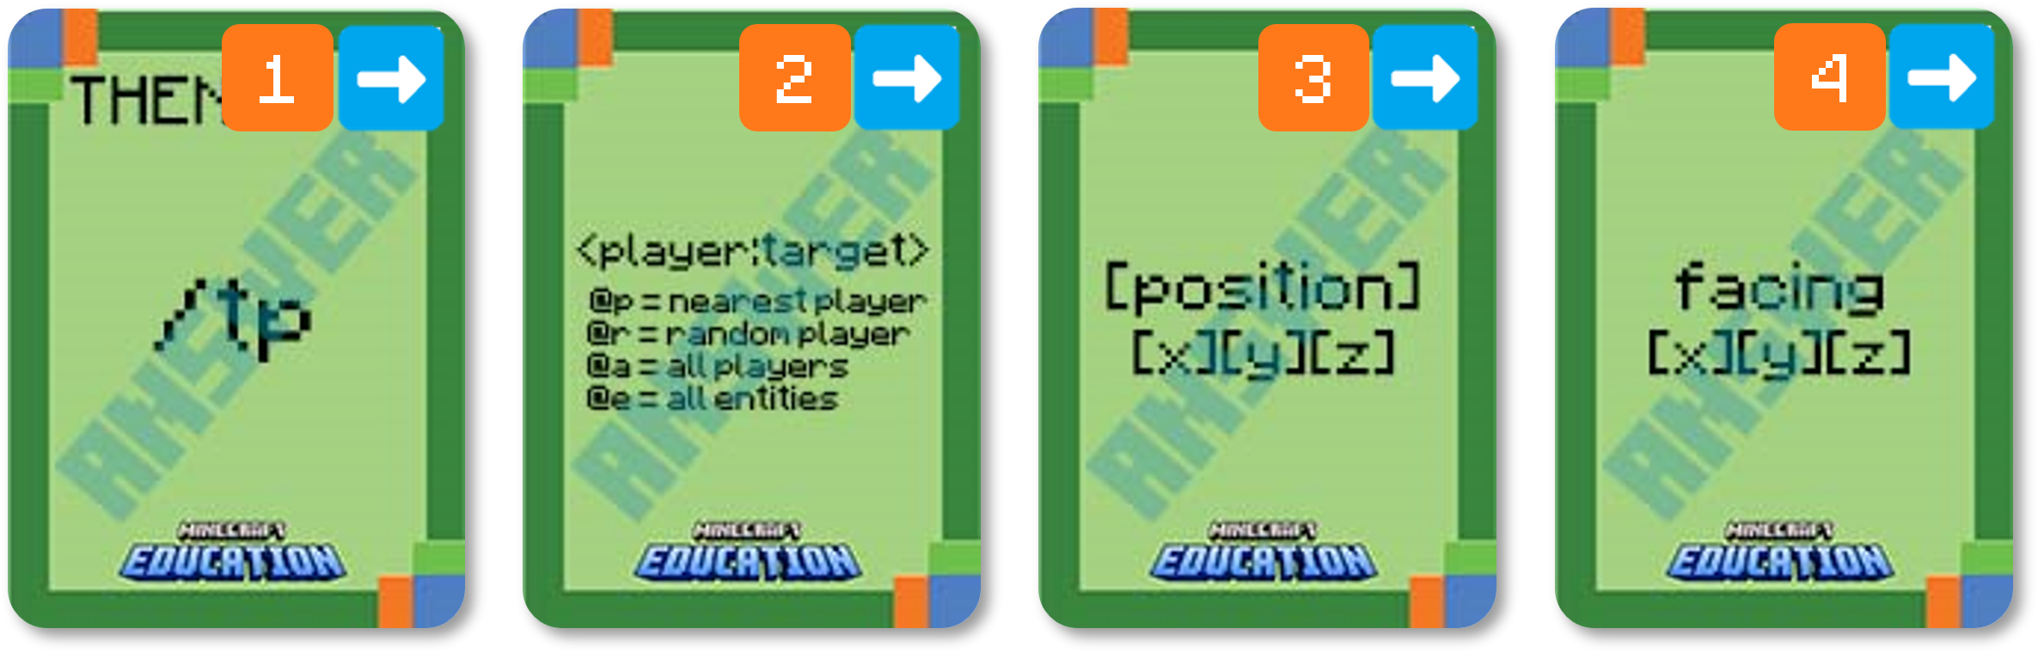

Use your coding cards to show the following command in the correct order.
Teleport Command
optional
player is the name of the player (or a target selector) to teleport.
x y z is the coordinate to teleport to.
facing is optional and is a set of x y z coordinates that the player will face after being teleported.
Notes:
Ask students to display which cards make up the following command. (the answer will be revealed card by card)
Break down the task by asking what each card does. (explanation will appear)
Challenge students to consider a gaming scenario that may use this command

Slide 3
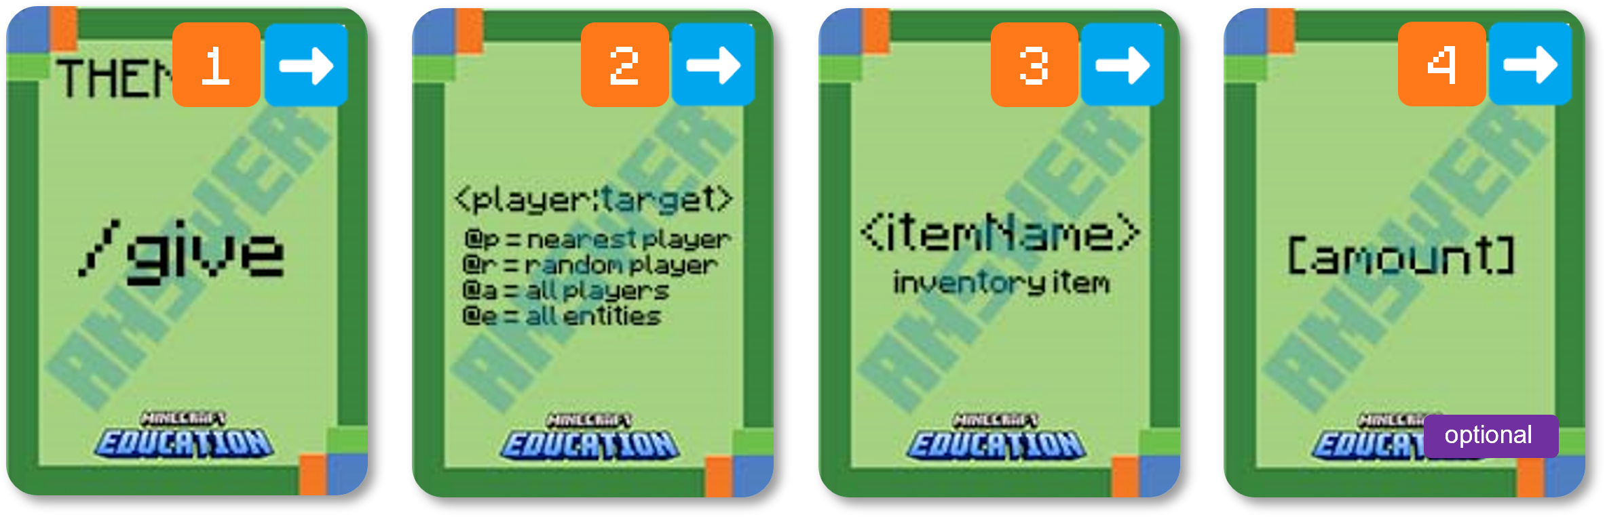
Use your coding cards to show the following command in the correct order.
Give Command
player is the name of the player (or a target selector) to give the item to.
itemName is the name of the item to give
The amount is optional. It is the amount of the item that you want to give. If you don't specify an amount, the player will be given 1 of the item.
Notes:
Ask students to display which cards make up the following command. (the answer will be revealed card by card)
Break down the task by asking what each card does. (explanation will appear)
Challenge students to consider a gaming scenario that may use this command

Slide 4

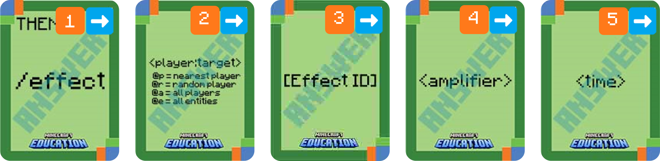


Use your coding cards to show the following command in the correct order.
Effect Command
3
4
player is the name of the player (or a target selector) who the effect will apply to.
Effect Minecraft ID refer effect you choose to enable.
time will determine how long the effect will last for.
amplifier applies the strength of the effect
Notes:
Ask students to display which cards make up the following command. (the answer will be revealed card by card)
Break down the task by asking what each card does. (explanation will appear)
Challenge students to consider a gaming scenario that may use this command

Slide 5
Beginners
Unpacking Algorithms

Slide 6
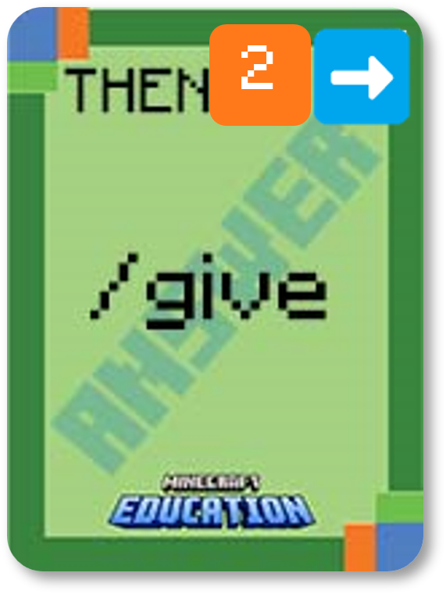
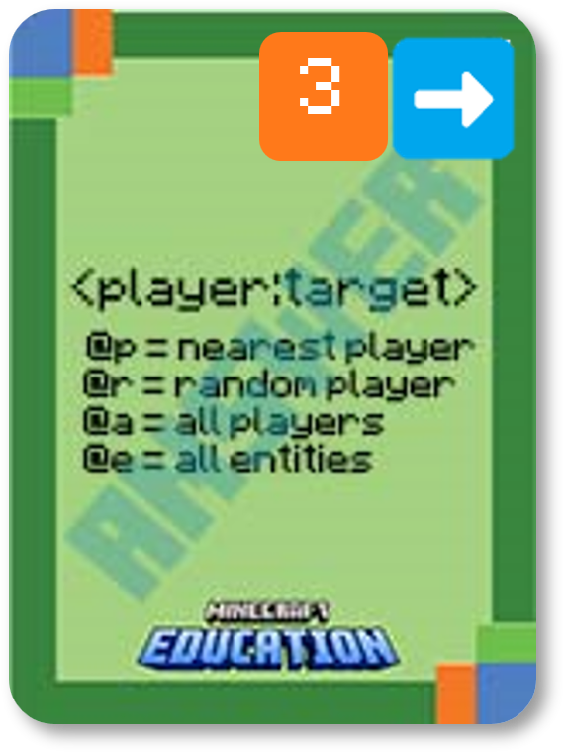
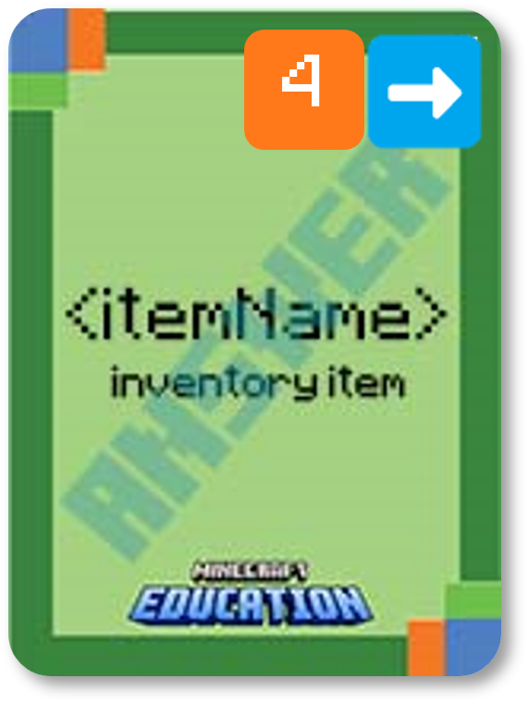
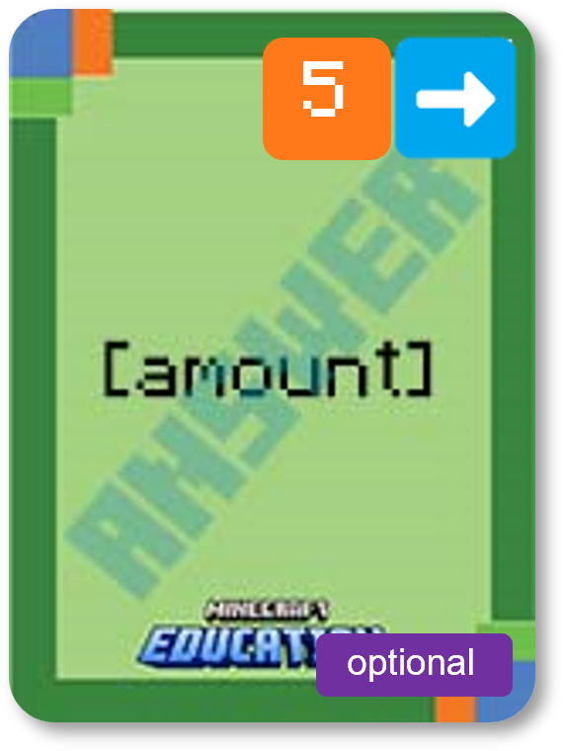
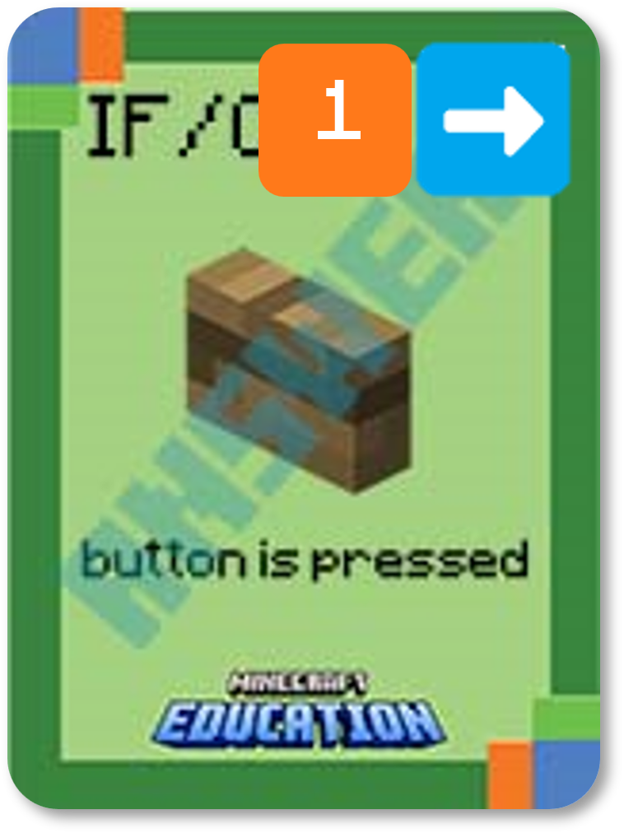
IF and THEN Statements
IF
THEN
Create a statement with a different IF card and explain how it would apply to a gaming scenario.
Decide who will be given the item, what they will get and the amount. Then explain how that could apply to gameplay.
Notes:
First, reveal the statement. You may like to only reveal the first card of the THEN statement and see if your students can determine the remaining cards.
Secondly, challenge your students to think of different IF cards and how this statement would apply in gameplay. They could share with the class and write their explanation in their book or OneNote.

Slide 7
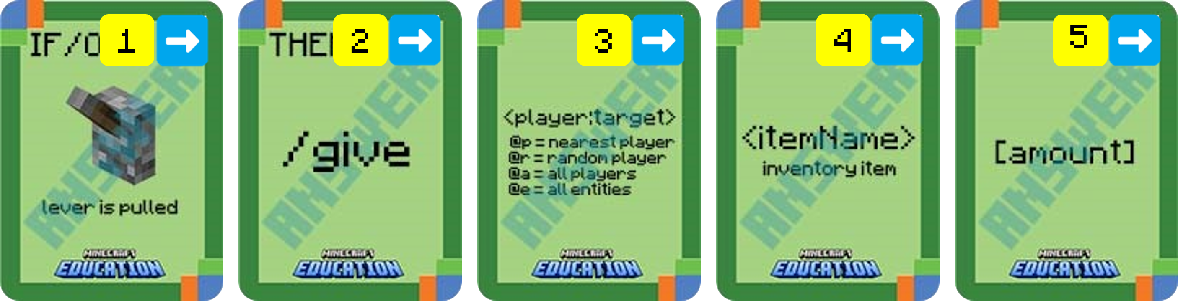
Place your cards in the correct order based on the following algorithm.
IF a lever is pulled, THEN give the nearest player an apple times 10.

Slide 8
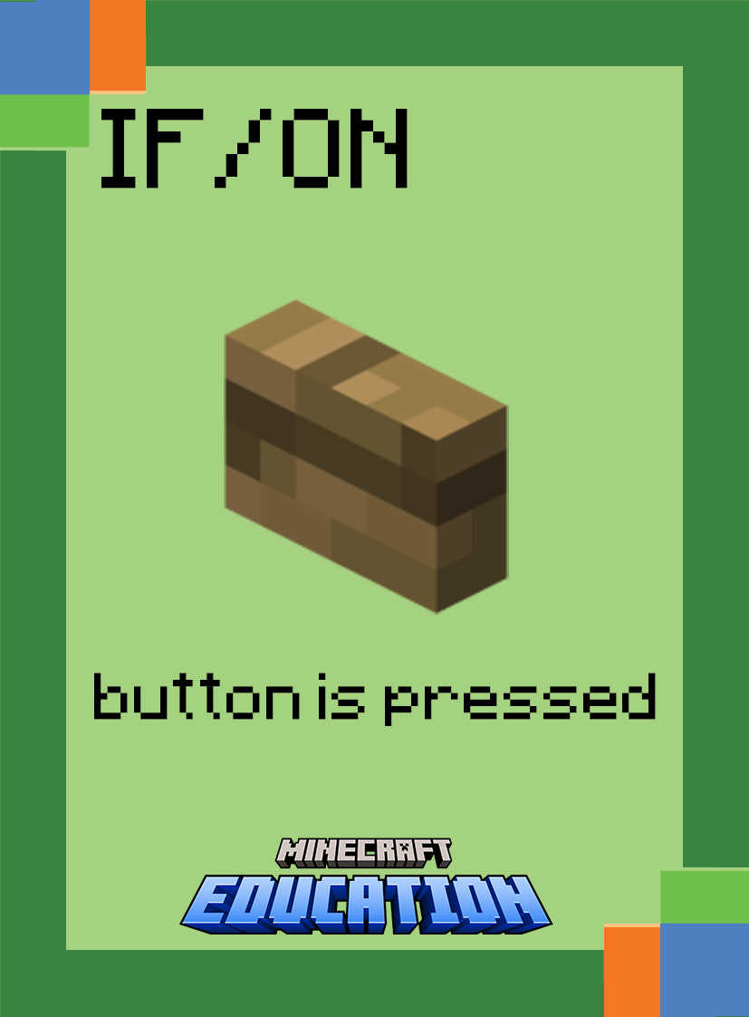
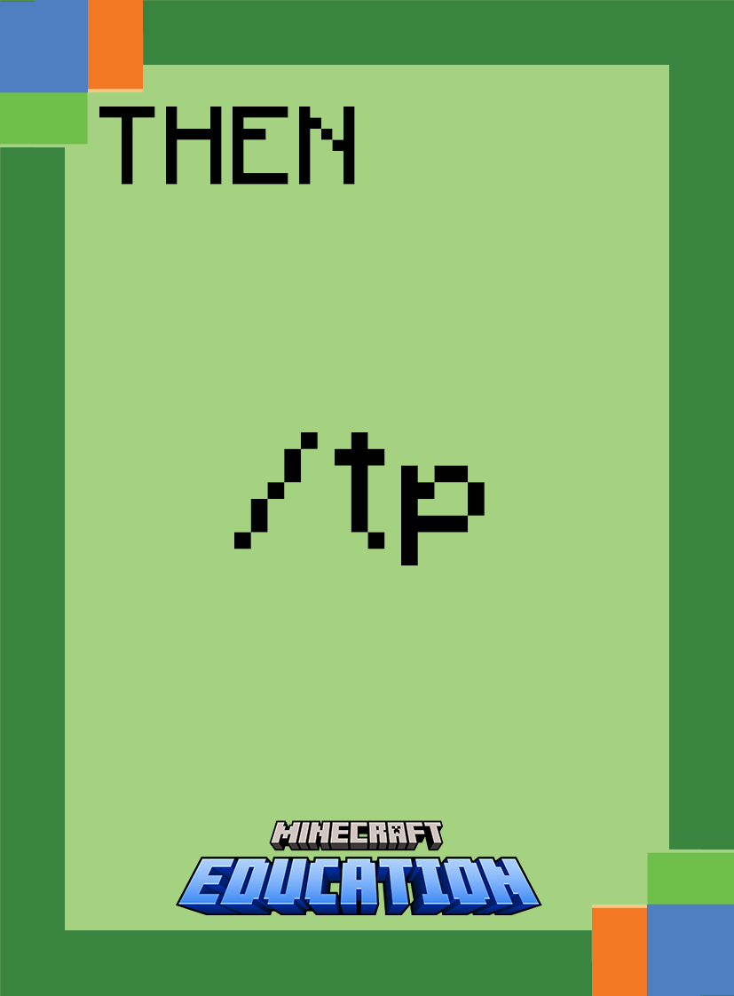
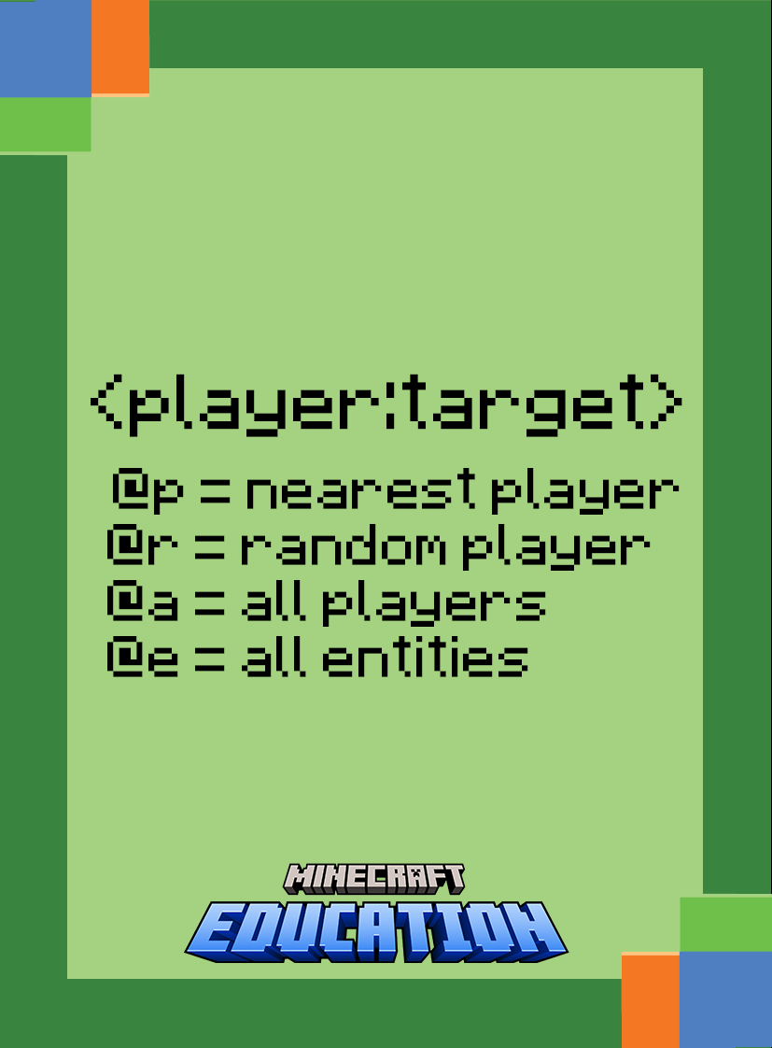

Place your cards in the correct order based on the following algorithm.
IF a button is pushed, THEN teleport the nearest player to 494 31 116.

Slide 9

Place your cards in the correct order based on the following algorithm.
IF a button is pushed, THEN teleport the nearest player to 494 31 116 facing 494 321 117.

Slide 10



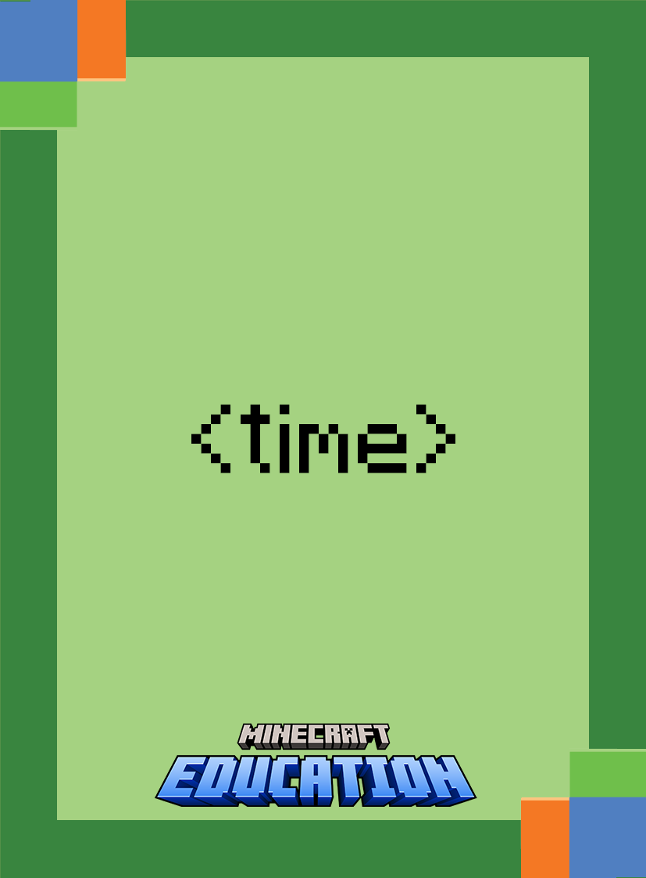

Place your cards in the correct order based on the following algorithm.
IF a player places a Redstone Torch, THEN give the nearest player the effect of water breathing for 10 seconds, amplified to 15

Slide 11
Beginners
Sorting Algorithms

Slide 12
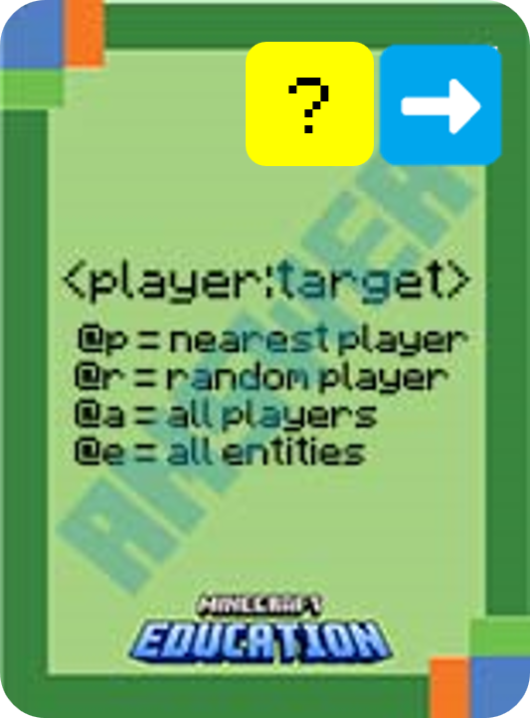
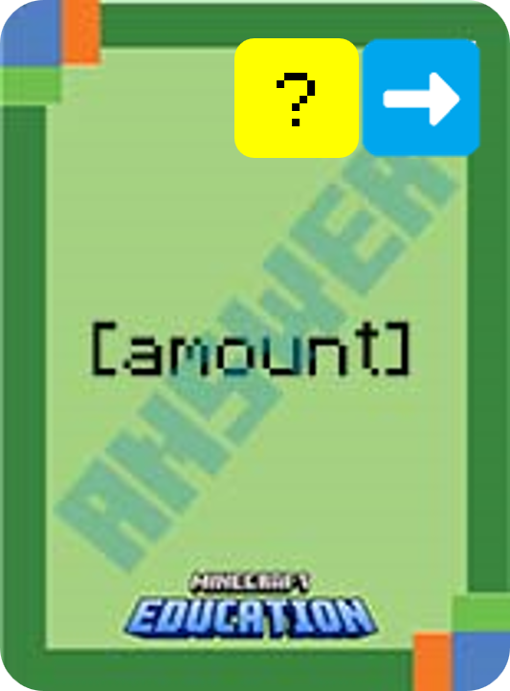
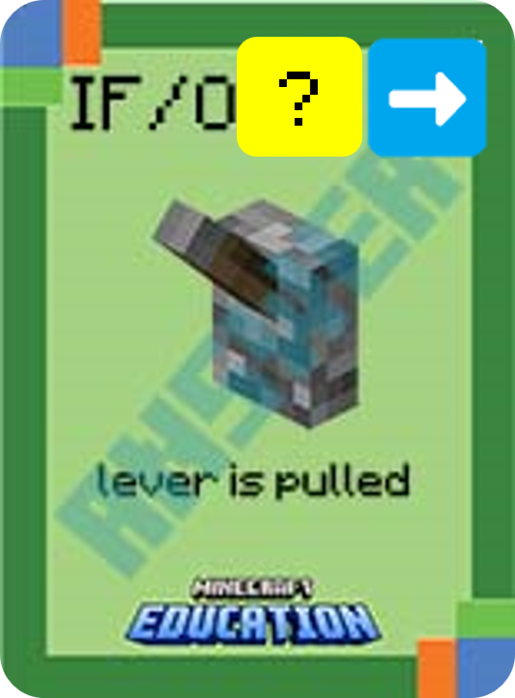

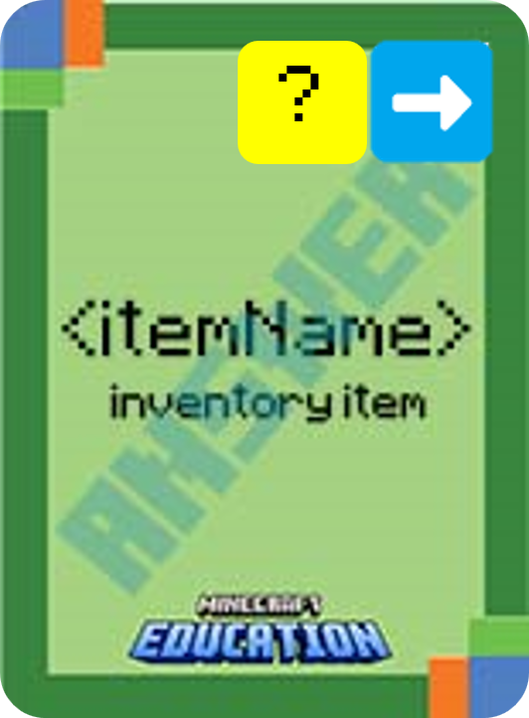
Using your cards, put this algorithm in the correct order:
Notes:
This is a fun game to play on a timer. Challenge students to use their cards and place the statement in the correct order.

Slide 13

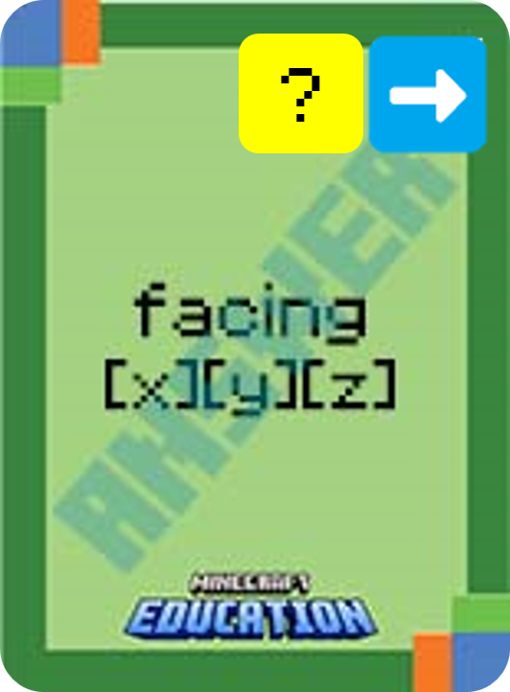
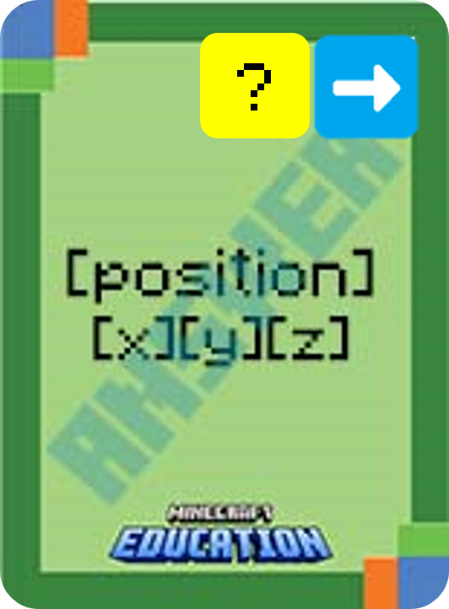
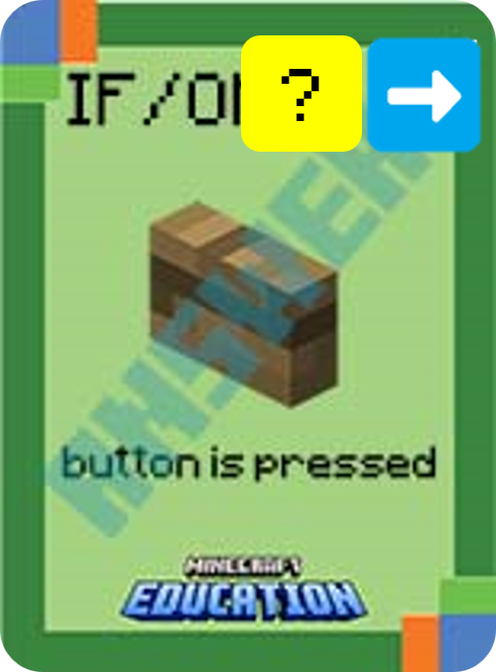
Using your cards, put this algorithm in the correct order:
optional
Notes:
This is a fun game to play on a timer. Challenge students to use their cards and place the statement in the correct order.

Slide 14
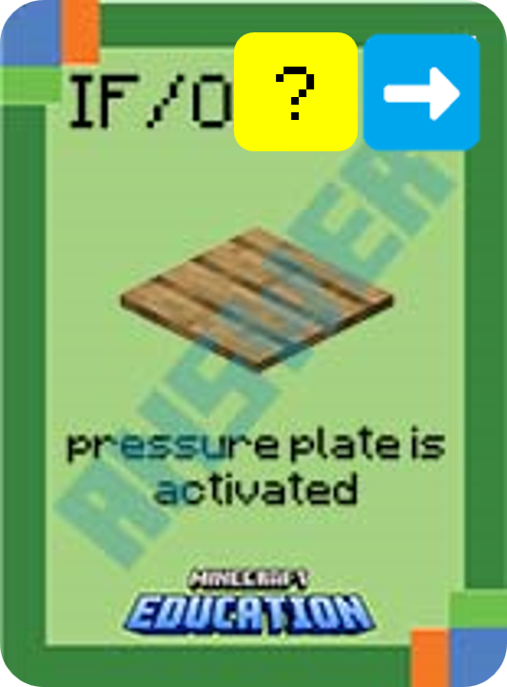





Using your cards, put this algorithm in the correct order:
6
Notes:
This is a fun game to play on a timer. Challenge students to use their cards and place the statement in the correct order.

Slide 15
Beginners
Identifying Errors

Slide 16
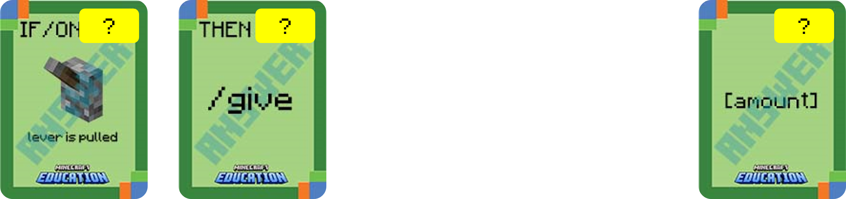

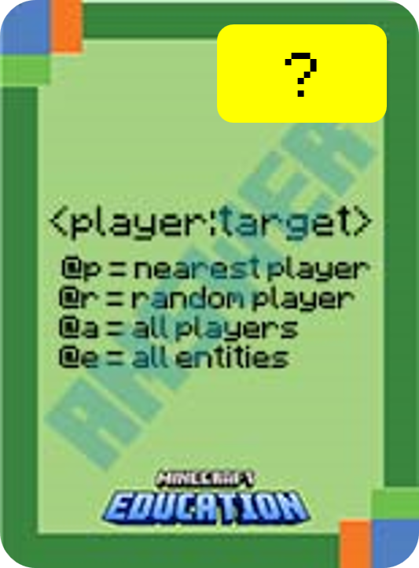
What’s wrong with this algorithm?
Identify the problem and use your coding cards to show the correct algorithm.
✔️
✔️
Notes:
Ask students to identify the error/s in the algorithm by using their cards to display the algorithm correctly.

Slide 17
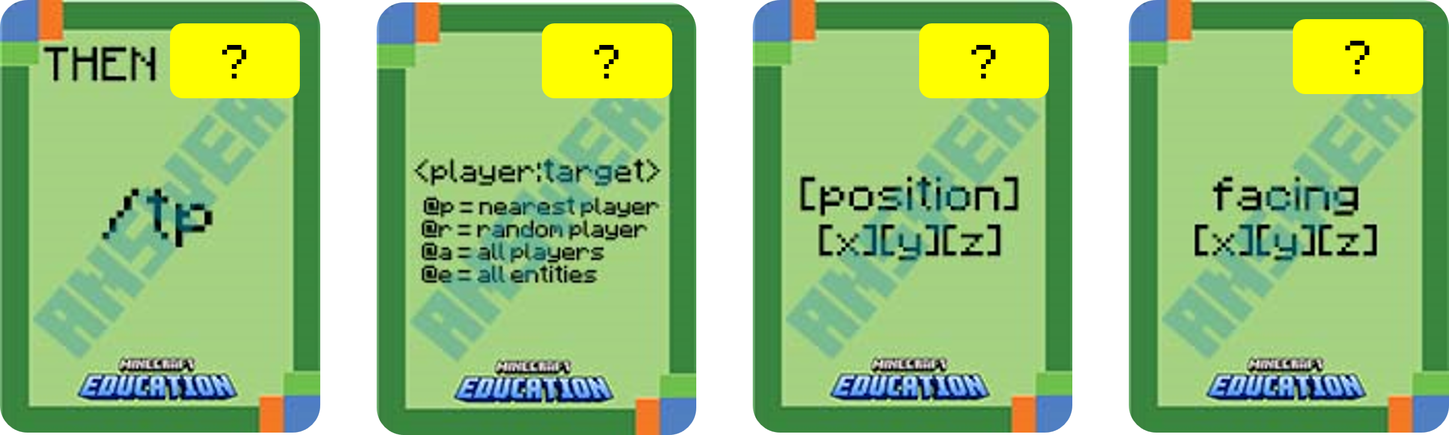

What’s wrong with this algorithm?
Identify the problem and use your coding cards to show the correct algorithm.
✔️
Notes:
Ask students to identify the error/s in the algorithm by using their cards to display the algorithm correctly.

Slide 18



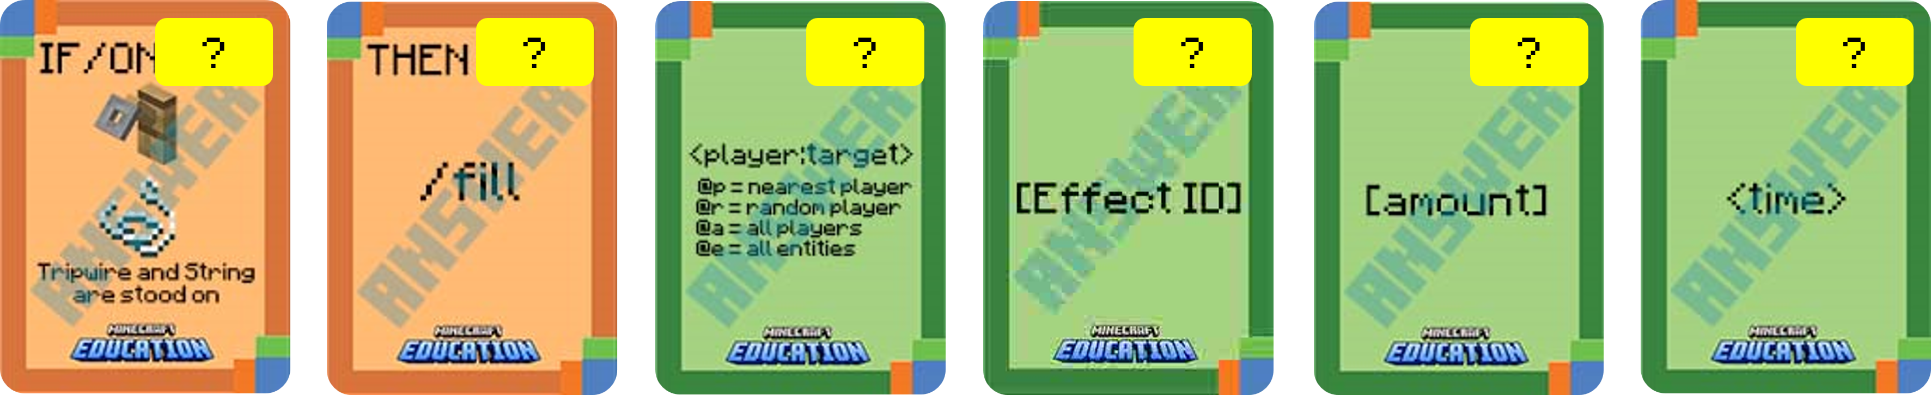
What’s wrong with this algorithm?
Identify the problem and use your coding cards to show the correct algorithm.
?
?
?
Notes:
Ask students to identify the error/s in the algorithm by using their cards to display the algorithm correctly.

Slide 19


Slide 20


Slide 21


