Slide 2

Examples
The following slides are examples of how you can show your coding in a PowerPoint

Slide 3
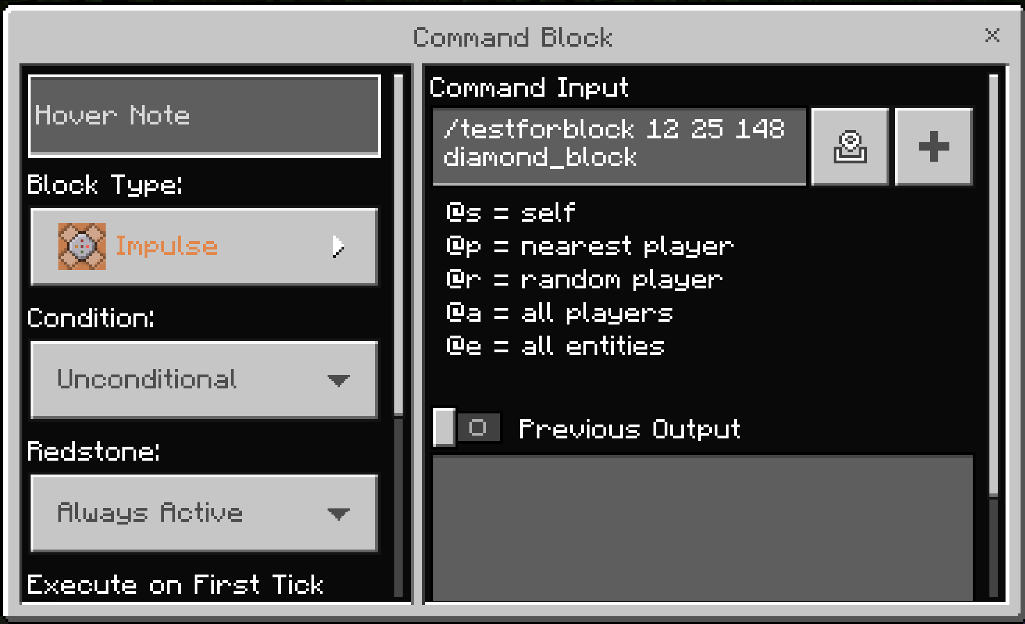
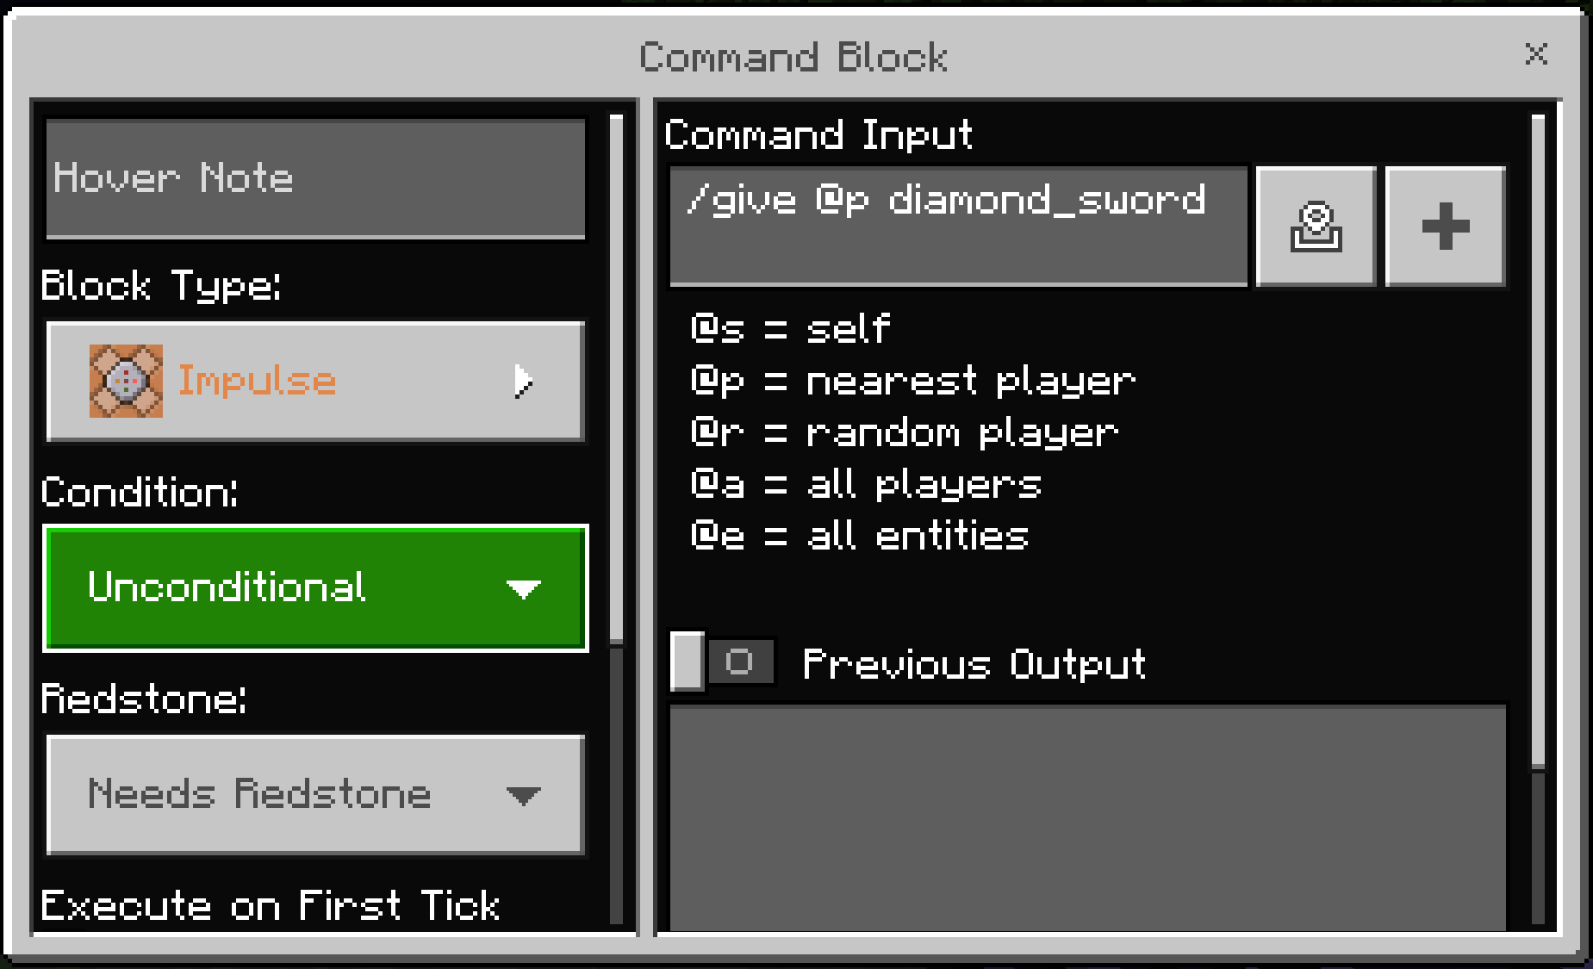
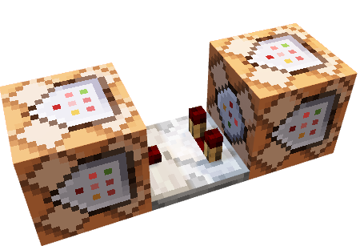
Slash Command Code Example
ON a block of diamonds being placed, IF a player places a block of the diamond at 12 25 148, THEN give the nearest player a diamond sword.

Slide 4
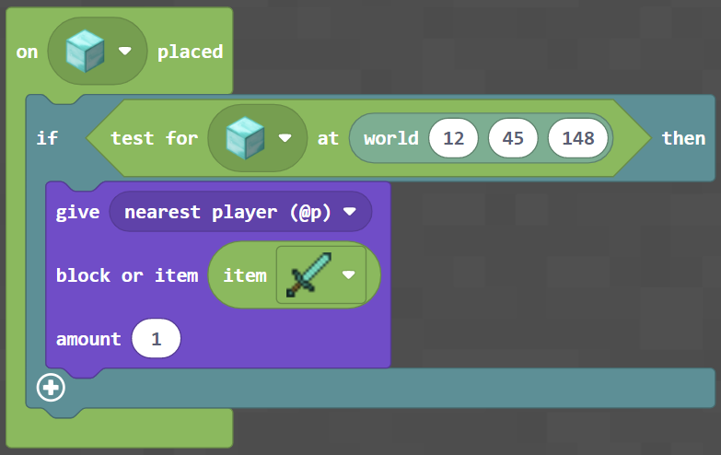
Block Coding Example
ON a block of diamonds being placed, IF a player places a block of the diamond at 12 25 148, THEN give the nearest player a diamond sword.

Slide 5
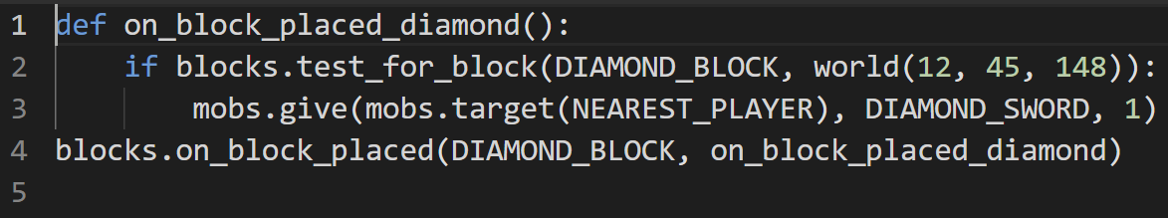
Python Coding Example
ON a block of diamonds being placed, IF a player places a block of the diamond at 12 25 148, THEN give the nearest player a diamond sword.

Slide 6
Theme Integration
Explain how your game meets the theme provided to you.
Add additional slides if required.

Slide 7
Gameplay Experience
What elements of your game make the overall experience enjoyable? How did you achieve this?
Add additional slides if required.

Slide 8
Creativity and Originality
What innovative ideas have you incorporated that will make your game stand out from the competition?
Add additional slides if required.

Slide 9
Coding Proficiency
How does your code support the game? What complex algorithms did you have to include to support the overall experience of the game?
Add additional slides if required.

